Slide 1
Independent Project: Visualizing Sustainable Industrial Processes using XR (VSIP-XR)
Guided By: Dr. Kalpana Shankhwar
Piyush Kumar
Tushar Chandra

Slide 2
Motivation
Addressing challenges of novice electronics soldering through "Visualising Sustainable Industrial Processes using XR (VSIP-XR)".
Leveraging Extended Reality (XR), particularly Augmented Reality (AR), to bridge the gap between theory and practice.
Creating a Soldering Simulator with precise recognition, real-time guidance, and an intuitive interface.
Empowering skill development in a risk-free environment while enhancing industrial process efficiency and sustainability through innovative XR integration.

Slide 3
Literature review
One influential study emphasizes PCBs' role in electronics manufacturing, stressing inspection to minimize defects. It focuses on automatic visual inspection, defect detection/classification, compares contact/non-contact measurement, and advocates a machine vision approach with experimental evidence for accurate, rapid PCB assessment.
Another important paper, introduces an AR-based system using smart glasses and custom software to train PCB assembly. It employs QR codes and markers to guide workers visually. A study in an EMS company showed flawless performance. The paper details the system, study, and outcomes, concluding its success and future prospects.
The IEEE paper introduces SMT in PCB production with solder printing, pick and place, and reflow steps. It discusses defect detection methods, favoring neural network-based solder joint inspection using diverse classifiers and image processing for optimal recognition rates.

Slide 4
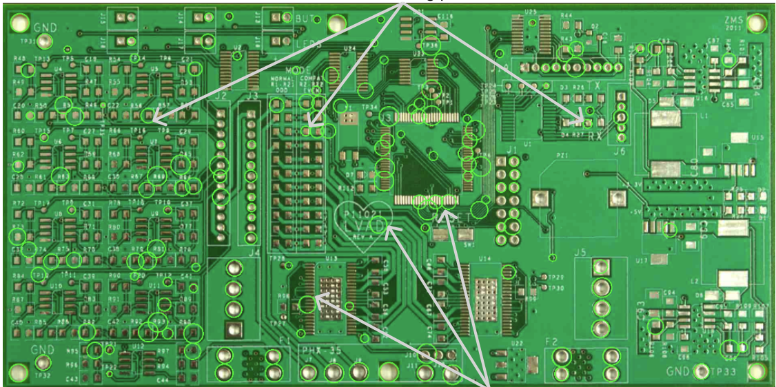
Methodology
Using Python & OpenCV
We first focused on 2D parts of our project, using OpenCV with blob-detector tools and a webcam to find holes on the PCB. Through an examination of the dimensions (radius) and spatial correlations among the holes, we identified possible soldering locations in red, effectively fulfilling the designated milestones for this problem statement.

Slide 5
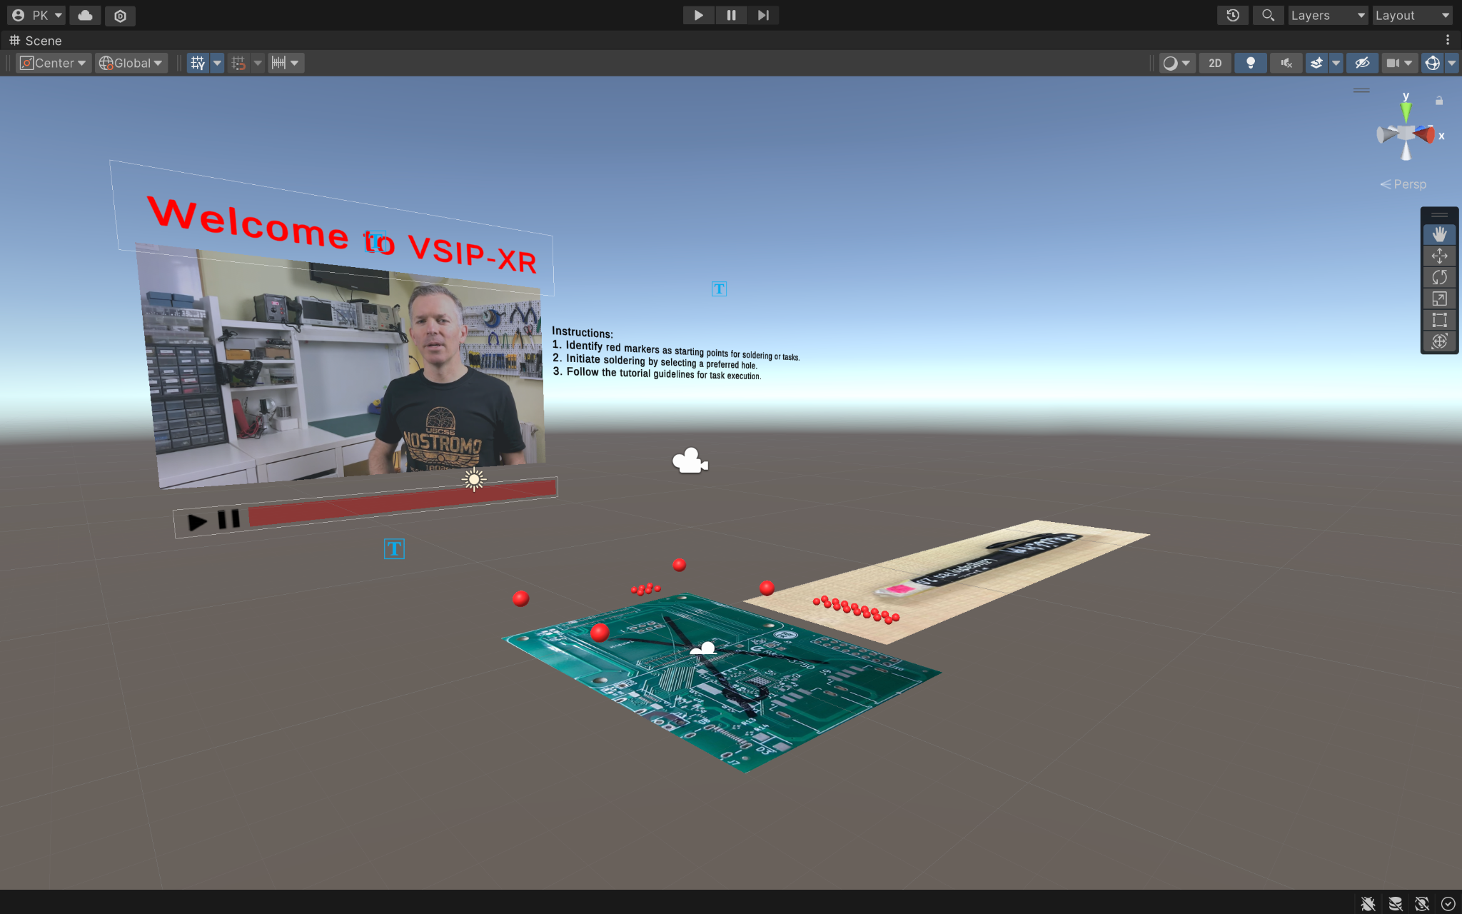
Methodology
Using Unity
The adoption of a 3D approach through Unity marked a significant shift in our methodology. By integrating Vuforia, markers facilitated precise red sphere overlays on identified holes. Unity's canvas embedded a video player for smooth user guidance, while dynamic instructions, aided by animations and C# scripts, enriched the soldering simulation, enhancing user experience with interactive 3D elements.

Slide 6
Methodology

Slide 7
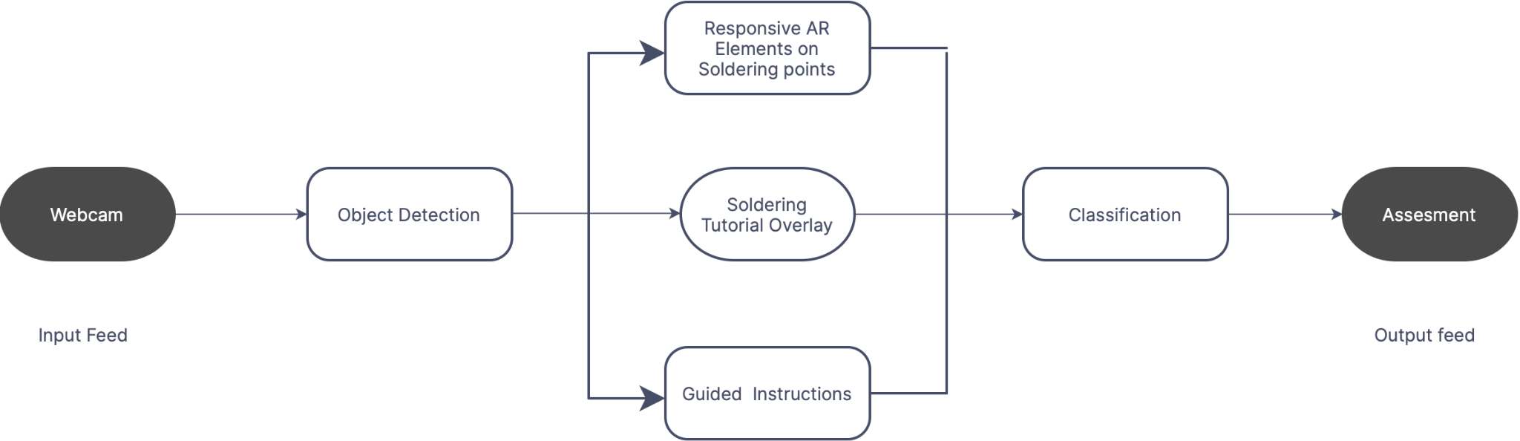
Workflow

Slide 8
Result & Analysis
Our innovative approach creates a realistic learning environment by integrating real-time training, accurate soldering point identification, and an intuitive UI.
As they advance in competence, users can practice soldering in a risk-free virtual environment.
The simulator's effectiveness lies in its ability to bridge the knowledge gap between theory and practice by giving aspiring practitioners a comprehensive education.

Slide 9
Timeline
Timeline for project
Brainstorming on problem statement
Transitioned to Unity for focusing on 3-D aspect of project. Started working with vuforia engine and Deploying 3D AR components
Week 2-6
Week 9-12
Week 1-2
Week 6-9
Worked on detecting holes on PCB using OpenCV and other libraries for targeting other 2-D aspects
Continued to add other functionalities like Video player, Instructions. Fixed bugs and worked on increasing accuracy.

Slide 10
Thank You

